Slide 1
Who are we?
GOD
“If”
“If”
Husband
Wife
“Then”
Who are we is based on WHOSE we ARE?
We are Bonded Beings!

Slide 2
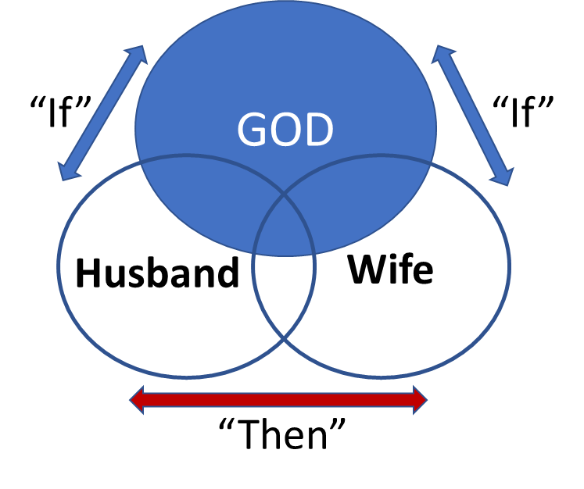
26 Then God said, “Let us make man in our image, after our likeness. And let them have dominion over the fish of the sea and over the birds of the heavens and over the livestock and over all the earth and over every creeping thing that creeps on the earth.”
27 So God created man in his own image,
in the image of God he created him;
male and female he created them.
28 And God blessed them. And God said to them, “Be fruitful and multiply and fill the earth and subdue it

Slide 3
How did the FIRST Husband and Wife impact how we became Bonded Beings?
How is WHO we ARE indelibly connected to WHOSE we are?

Slide 4
1. God created Humankind to uniquely Represent His Purposes (Gen 1:25-27),
“An image is NOT the Original but can be created from the original to represent the original
Implication for Marriage:
God designed a Man and Woman to be His Exclusive Image bearers designed to represent His purposes in the World.

Slide 5
2) God created humankind to Resemble His Character (Gen 1:26-28,
Humankind resembles God: This is captured in the word “likeness”.
“Likeness” carries the idea of resembling characteristics of the original.
Because God is love, humankind was to love. God is Grace; humankind is to demonstrate grace. God is merciful, Humankind is to be merciful; God is kind, forgiving, compassionate, patient, gentle, etc.
Implication for Marriage: Marriage is the Perfect Relationship for a man and a woman as two distinct and diverse people to resemble God’s Characteristics to one another.

Slide 6
3) God created Humankind to Reflect His Glory (Isaiah 43:7, Romans 3:23),
Just as the Sun is the Source of Light, and light is the reflection of the Sun, so the creature was to reflect the Creator.
God said of Israel in Isaiah 43:7, God says if all humankind “I created you for my glory”.
Implication for Marriage:
Marriage is an incredible opportunity to reflect WHO God is and WHO you are as a couple in relationship to God. This is THE Evangelistic tool for a Broken World.

Slide 7
4) God created Humankind with the Distinct Respective Roles for God
“…male and female he created them…” (Genesis 1:27).God designed Human Beings to be Gendered Beings. Humankind represents the image of God and resembles the likeness of God through the distinctive diversity of being “male” and “female”.
There is also a need for an equality and dignity in role and function. “Be fruitful and multiply” and “have dominion” (over all the earth). (v28)
Implication for marriage? “The words male and female coming at this juncture, have far-reaching implications, as Jesus made plain when he coupled them with 2:24 to make the two sayings the twin pillars of marriage (Mark 10:6, 7). To define humanity as bisexual is to make each partner the complement of the other, and to anticipate the New Testament doctrine of the sexes’ spiritual equality (‘all one’”)” Derek Kidner

Slide 8
5) God created Humankind to Rule God’s World – His way (Genesis 1:26-27)
Humankind were uniquely designed to be God’s Ambassadors, Kings and Queens, Viceroys… Ruling God’s World, God’s Way.
Humankind should take ownership is found in Genesis 1:26 and verse 28 that is the Role of a Servant Leadership who RULES for God. “Dominion over”.
Implications for marriage:
Rulership is always subject to the role of Service under God. Dominion is a form of Worship. When we do not follow God’s Word and Rule for ourselves this creates division in a marriage.

Slide 9
6) God created Humankind with the ability to “Retrace” their own Histories.
Genesis 2:4- “These are the generations of the heavens and the earth when they were created”
“Toledoth” comes from a Hebrew verb which means to “give birth to, bear”. The term “Toledoth” is a way of saying “this is the history of or the generations of” each family line”.
Implications for marriage
From Genesis 3 this becomes important in tracing the intergenerational “sin” and “curses”. (Today this is known as “Epigenetics”).

Slide 10
7) God was resolute that Humankind was FORMED as a Living SOUL, dependant on God as Their Creator. (Genesis 2:7)
God created Humankind NOT just with a Body that has a soul, we ARE SOUL in a body. The Body is the Vehicle! But the BODY does NOT make up the person.
The SOUL is the PERSON. Our Bodies will perish, NOT our souls.
The reason we think, strategize, desire, will, decide, feel, express, and after Genesis 3 want, demand, covet, compare, consume, and have longings is ALL because we ARE SOUL.
Implications for marriage: When sin enters the World…the Soul becomes corrupt which influences the heart and mind.

Slide 11
8) God created Man to be Responsible for Service and Steward of God’s World and God’s Word – Adam (Genesis 2:15, 2 Timothy 3:11-17),
Genesis 2:15a – “The LORD God took the man and (strategically) put him in the garden of Eden to work it and keep it.” “To Serve” God and “Protect” what is entrusted to him.
Adam was strategically placed. The Hebrew verb for “put” in Genesis 2:8 means to “appoint, set or place”.

Slide 12
God created Adam to be Responsible for Service and Steward of God’s World and God’s WORD!
God “commanded the man”. (Genesis 2:16)
This command was given some time before God creates the woman.
Responsibilities and restraints for a Principled Life - Genesis 2:16-17 provides a catalyst for their on-going maturity, growth and development BEFORE and UNDER God.
“Command” means Truth that guide someone purposefully towards an end goal of maturity and growth. A command defines the context of a particular but interrelated purpose.
Implications for marriage: Whose WORD do we follow?

Slide 13
9) God created the Woman to be a Reasoning Complimentary Counterpart – (Genesis 1:19-3:6, Proverbs 31:10-31)
Genesis 2:18-Then the LORD God said, “It is not good that the man should be alone; I will make him a helper fit for him…. 20 The man gave names to all livestock and to the birds of the heavens and to every beast of the field. But for Adam there was not found a helper fit for him.
Notice in Genesis 2:19 that God “brings” the animals to Adam to name. This seems to highlight his divinely ingrained “deficiency”. Each animal seemed to have a name and a partner –BUT him. None of the animals were compatible as a complimentary counterpart –yet as he named the animals each of them had a partner that complimented them.
Adam sensed a deep deficiency, a deep need- “he was alone”. There was NO partner for him. Adam was designed as a relational being.

Slide 14
9) God created the Woman to be a Reasoning Complimentary Counterpart – (Genesis 1:19-3:6, Proverbs 31:10-31)
Adam needed a physical partner like him but Adam could not find one
God designed man to work interdependent with another who complimented him, and He her.
God designed an “ezer”. We see the word “ezra” (Helper) in Genesis 2:18, 22. “Helper” is an inclusio- a bracketed thought. The Helper was the solution. God’s Solution.

Slide 15
9) God created the Woman to be a Reasoning Complimentary Counterpart – (Genesis 1:19-3:6, Proverbs 31:10-31)
Suitable” suggests a person who was significantly different from him so as to contribute distinctively to his life, as a counter part, yet one who was of the same essence and on the same level.” John Hartley
Woman was to be equal but distinct. Exalted and contributing in a diverse unique collaborative way that enriches the relationship.
“Helper” and “Suitable” carries the ideas of
- One that closely resembles another.
- One that has the same functions and characteristics as another; a corresponding person.
- One of two parts that fit and complete each other.
- One that serves as a complement.
- One who is a counterpart that protects, aids, helps, supports

Slide 16
10) God creates the ultimate Romance and depth of Relationship
God designed the ultimate secure attachment between two people.
Genesis 2:21-22 – “So the LORD God caused a deep sleep to fall upon the man, and while he slept took one of his ribs and closed up its place with flesh. 22 And the rib that the LORD God had taken from the man he made”
God as the Perfect surgeon, specifically “makes” or rather “builds” a perfect partner for Adam. God as the Great Surgeon puts Adam “under anesthetic” in a deep sleep.
Adam has NO part in the woman’s creation. God knows WHO Adam Needs!!! Adam is to be the recipient of God’s gracious provision of a partner.

Slide 17
“The use of “build” instead of “form” underscores that the woman was made of the same substance and according to the same model as the man.
“Furthermore, the fact that God made the woman establishes her as a person in her own right. These details teach that no other living creature could ever become woman’s rival in serving as man’s helper, counterpart, and intimate companion” John Hartley

Slide 18
Matthew Henry:
“The woman came out of a man’s ribs. Not from his feet to be walked on, not from his head to be superior, but from his side to be equal, under the arm to be protected, and next to the heart to be loved.”

Slide 19
God brings His Daughter, and He walks Her down the aisle, to Adam!
“And the rib that the LORD God had taken from the man he made into a woman and brought her to the man. 23 Then the man said, “This at last is bone of my bones and flesh of my flesh; she shall be called Woman, because she was taken out of Man.” (Genesis 2:22-23)
There are some critical observations and implications for marriage:
(1) God brings the Woman to the Man. “Without doubt, the verse conveys the idea that the institution of marriage is established by God Himself”. Nahum Sarna

Slide 20
some critical observations and implications for marriage
(2) There was no mistaking that she was unique and different by Adam’s reaction! This is the first “Hallmark Moment”! This is the first love poem. Think about this. THE FIRST WORDS RECORDED BY MAN is a LOVE POEM!!! These are the Frist words recorded before the FALL!
(3) “The image of shared flesh illustrates the complete bond of marriage. All that affects one, affects the other. To hurt one is to hurt the other” . Bruce Waltke
(4) “The equality of man and woman are found in Adam naming her “woman” (ʾiššâ) (ish-shaw) he also names himself “man” (ʾîš) (eesh). Although Adam means “ground”, Adam names himself in relation to his wife. A man and woman are never more like God than on their wedding day when they commit themselves unconditionally to one another.” Bruce Waltke

Slide 21
some critical observations and implications for marriage
(5) Adam understood himself as a Husband. This is important when thinking of God as the Husband of Israel keeping His Covenant.
Jesus as a greater model of a Groom who purchases His Bride with His own life and calls Husbands to live a sacrificial life in love for their wives (Ephesians 5:21-32)

Slide 22
“Therefore a man shall leave his father and his mother and hold fast to his wife, and they shall become one flesh. 25 And the man and his wife were both naked and were not ashamed.”
(6) Every marriage is divinely ordained. “The inspired explanation aims to correct cultures that give priority to the parental bonds over the marital bonds.
Secure Parental Bonds lay the foundation for secure marital bonds!!
(See Proverbs 2:17…Malachi 2:14-15)
This is found in “leave”. Because husband and wife are one flesh, the bond of marriage has priority in that all husband and wives are to be married centered NOT PARENT or Child centered. (This does not mean that parents are not to be honored and respected and taken care off in their old age or when needed)

Slide 23
(7) They “Become” “one flesh”. God’s intention that marriage be exclusive, monogamous is implied by the complete unity and profound solidarity of the relationship
Physically: SEX IS THE result of Oneness in a Covenant Relationship. Because of the Priority of this exclusive relationship designed by God in marriage between a Man and a Woman, This is a Spiritual, Cognitive and Emotional “running between the two – intercourse”, There can be the Pleasurable “sexual intercourse” between the two, reserved for marriage alone!
There is an exclusive, private, beautiful, joining together “12 A garden locked is my sister, my bride, a spring locked, a fountain sealed….. 15. a garden fountain, a well of living water….16. Blow upon my garden, let its spices flow…. Let my beloved come to his garden, and eat its choicest fruits. 5:1 I came to my garden, my sister, my bride… God Speaks and Gives His approval: “Eat, friends, drink, and be drunk with love!
Even after the FALL Marriage can somewhat return to Eden…..Sexual relationship is NOT just for Procreation but Pleasure! Continually to be refreshed… (See 1 Corinthians 7:1-5)
“ Let marriage be held in honor among all, and let the marriage bed be undefiled, for God will judge the sexually immoral and adulterous” (See 1 Thessalonians 4:3-8)

Slide 24
(9) “And the man and his wife were both naked and were not ashamed.” (Genesis 2:25)
As long as they were in Relationship with God Horizontally, they could be could be totally “naked” Vertically! They could be exposed and safe. Open and authentic. Mutually meeting one another's needs.
There was no need to hide from one another. No need to conceal, pretend, cover, be defensive, avoid, protect themselves…

Slide 25
10) Marriage is an exclusive Covenant made up of
Guaranteed Closeness
Modelling Sacrificial Service to one another
Mutual agreement of defined values
Seek to understand the others
Available to speak with one another
Exclusive Secure Base to return to
Exclusive Safe Haven to be open with one another
Attune to one another emotions
Meet one another's needs
Persevere with one another when tested.
How do these define and
characterise our marriage?

