Slide 1
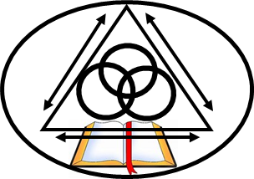
Pray: Prepare your heart individually before the LORD.
Isaiah 57:15
Psalm 139:23-24
Psalm 51:6, 10-12
John 3:19-21
Ephesians 5:9-13, 14-18,
21-33
Colossians 3:1-4

Slide 2
Who do we really believe we “belong” to?
What does it mean to be “bonded”? What does bonding involve?
What has actually gone wrong in our marriage? How would we describe ourselves as “Broken”, “Blind”, “Bias” and “Blaming” individually and collectively as a couple? What do we just not talk about as a couple? Why?
How do we address being “new” at marriage? Not “Broken” but immature and needing to grow?
How humble and teachable are we individually and as a couple?
Would we consider ourselves being “right with God”? What does that mean?
How do we deal with the inevitable failures and challenges in our marriage?

Slide 3
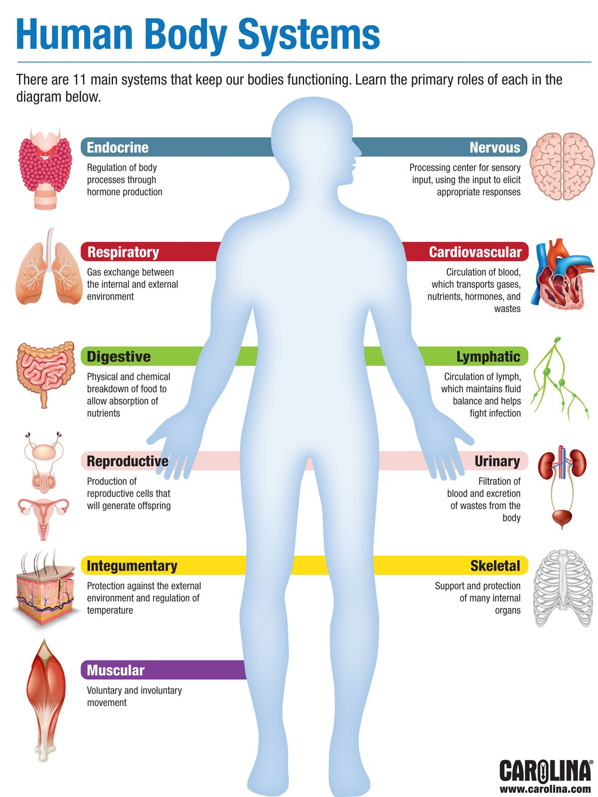
eye is a complex optical system
Nose: oflactory system
Ears: auditory system.
.
1. The Human Body is strategic attachment system

Slide 4
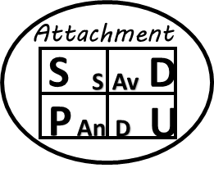
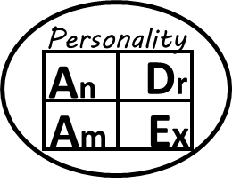
Strategy/Task 1
Strategy/Task 2
Strategy/Task 3
Strategy/Task 4
Strategy/Task 5
Humble &
Teachable
W
D
Negative
Attitudes
Strategy/Task 6
A
E
Strategy/Task 19
Strategy/Task 20
Contribution
Conscience
Strategy/Task 18
S
Sabotage
Needs
Demands
Mourning
“A’s”In Conflict
Restoration
L E A D E R S H I P
Theology of Suffering
Grief
=
R
V
A
N
T
Responsibility
9
Tasks
Ownership
Opportunity
In
me
S/A
S/M
S/D
S/C
Choices
Perseverance
Mutuality
Accountability
Meaning
MATURITY
Skills
Strategy/Task 7
Thru
Me
M/A
O/A
D/P
C/C
Strategy/Task 13
Covenantal
“into-me-see”
22T
Strategy/Task 17
Strategy/Task 14
asks
ests
G.F.
Strategy/Task 8
Complex
Strategy/Task 12
G.C.
1-14
15-22
Trauma
Communication
M.S.S.S
Open
Blind
R. I. P. P. P.
Triggers
Un-
known
Hidden
A
S.U.
S
H
.N.T.
A.U.
M
Strategy/Task 10
Strategy/Task 15
Strategy/Task 11
&
A.S.
E
S.B.
A.d.d.i.c.t.i.o.n.
R.e.c.o.v.e.r.y.
Defenses
G
R
7
L.O.V.E.
U
L
15-22
Strategy/Task 16
S.H.
I
T
S.O.U.L
S.I.N.
H.E.A.R.T
M.I.N.D.
A.E.
N.U.M.B.
Strategy/Task 9
S.T.R.E.N.G.T.H
M.N.
I.D.O.L.S
P.U.

Slide 5
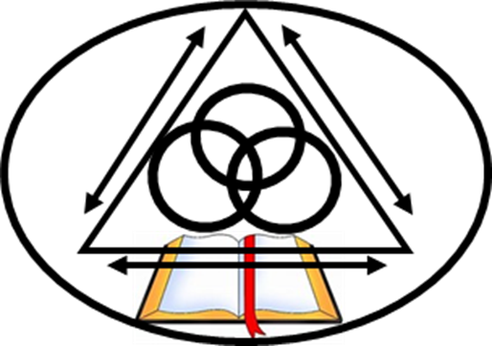
Lesson 1 - Whose are we?
Matthew 28:19
2 Corinthians 13:14 (See vv5-14, v9, 11)
Colossians 3:1-4
WHO do we belong to?
What/Who is the starting point, direction and focus of our Marriage?
Horizontal or Vertical?
EVERYTHING proceeds from this starting point. (Ask Solomon – Ecclesiastes 2:1-10)

Slide 6
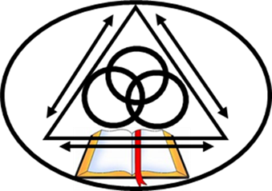
WHO is the starting point for our marriage? 1. God is Self Existent…..“In the beginning God…” Genesis 1:1
“What comes into our minds when we think about God is the most important thing about us. ...” A. W. Tozer

Slide 7
“For I am God, and there is no other; I am God, and there is none like Me” (Isaiah 46:9)
“The God who made the world and everything in it, being Lord of heaven and earth, does not live in temples made by man, 25 nor is he served by human hands, as though he needed anything, since he himself gives to all mankind life and breath and everything.” Acts 17:24-25
Implications for marriage? We need God. He doesn’t need us. Going to church every Sunday as a couple is not a favor we do to him, it is an act of humility on our part. It is you understanding that we need help from God or this marriage is toast!

Slide 8
2. Jesus is Self Existent. –
Jesus shares God’s Self existence, Hence, Jesus IS God. John 8:58 – “BEFORE Abraham…I AM!”
“In the beginning was the Word, and the Word was with God, and the Word was God. 2 He was in the beginning with God. 3 All things were made through him, and without him was not any thing made that was made. 4 In him was life, and the life was the light of men” (John 1:1-4)
Implications for marriage? This is important! We have a Savior WHO is God!.....and knows what it means to live life in this Broken World

Slide 9
3. Holy Spirit is Eternal and Self existent – The Third Person of the GodHead (See Ps. 104:1–3, 30) (Bazalel - Ex. 31:1–5).
“The earth was without form and void, and darkness was over the face of the deep. And the Spirit of God was hovering (“waiting to act” over the face of the waters” (Genesis 1:2)
“But when the Helper comes, whom I will (Jesus) send to you from the Father, the Spirit of truth, who proceeds from the Father, he will bear witness about me” (John 15:26)
Implications for Marriage? We need the Holy Spirit in marriage to “check” our spirit when we loose perspective. If we are humble and teachable The Holy Spirit will convict us of what ATTITUDES we need to address! (1 Corinthians 2:9-16, John 16:9-11)

Slide 10
4. God strategically and intentionally designed creation through a deliberate thought out process.
1) What God starts He completes. God sees it through.
Implications for marriage: Genesis 1:1 “create” is a telic verb – which mean what God starts He finishes!
If we trust Him God WILL see our Salvation and marriage through to the dy we die! (See Philippians 1:6, John 4:34, John 19:30)
Marriage is TOUGH! Marriage becomes a critical point of growth, particularly when suffering or tested (See James 1:2-8). Marriage becomes an exclusive Covenant maturing in a Fallen World. We need carefully prepare for marriage so we can see it through!

Slide 11
2) God forms Order out of Chaos - “The earth was without form and void, and darkness was over the face of the deep…” (Genesis 1:2b)
The Hebrew words for “without form” and “void” will at times speak of a Desert wasteland where there will be testing and maturing due to disobedience but also maturing
Implications for Marriage:
What does “chaos” and “difficulties” reveal according to Deuteronomy 8:1-5
Difficulties reveal what is really going in our heart and mind (James 4:1-2)
Difficulties tests whether we are humble and teachable
Difficulties test WHOSE we really are…Will we rely on God and His Word or seek our own solutions?

Slide 12
How did God strategically and intentionally design creation through a deliberate thought out process?
What are the implications for marriage?

Slide 13
1) God Intentionally Speaks. God Announces. “And God said” (1:3) – God has exclusive intent
Implications for Marriage?
God has a DIVINE Intent for YOUR Marriage!
God speaks into existence…God has an exclusive intent for His Creation.

Slide 14
2) God Commands! - “And God said, Let there be!!” (Genesis 1:3b)
When God commands through out Scripture
Proves – quality and reality of someone
Provides - what is beneficial for us (James 1:17-18)
Protects them for Chaos. “God Creates Order out of Chaos” (Genesis 1:2)
Preserves Order, Structure and Beauty out of chaos with Him and Relationships with One another.
Follows a Process and Procedure – The is a really good reason why He said what He said!!!

Slide 15
3) God’s Design– LIGHT. “God said, Let there be light” (Genesis 1:3c)
“Light” will become a profound spiritual and practical theme AND solution for Covenant Relationships with God and others throughout the Bible (1 Tim 6:16, Ps 36:9 of God, Ecc 11:7, Ps 27:1, Ps 119:130, Prov 6:23, Job 24:13, Jn 3:19-20 ).
Implications for marriage?
In marriage – The Light of God’s WORD must be used to expose thoughts of the heart (See Ephesians 5:9-18)
For all that is secret will eventually be brought into the open, and everything that is concealed will be brought to light and made known to all. (Luke 8:17 NLT)

Slide 16
4) God Fulfills – “And there was light” (Genesis 1:3d)
God fulfilling and being true to His WORD will be a critical theme throughout the Bible in Covenant Relationships. (Eph 1:8; Job 12:13; Pro 8:14;, Isa 28:29, Isa 40:13, Isa 40:14; Jer 23:18, Jer 32:19; Zec 6:13; Act 4:28, Act 20:27; Rom 11:34)
Implications for marriage?
Fulfillment has nothing to do with “happiness” but thought out good that moves a couple towards a sense of satisfaction and joy because they lives life God’s Way.

Slide 17
5) God evaluates – “God saw…” (Gen 1:4)
Only God had the ability to discern and evaluate what had been created for the benefit of humankind who live in His created order.
(Later this will be a contrast with Lot in Genesis 13:10).
Implications for marriage?
The “lens” we use to evaluate what is “good” and “evil” is critical in marriage?

Slide 18
6) God approves - –“God saw that the light was good” (Gen 1:4).
“Every good and perfect gift is from above, coming down from the Father of the heavenly lights, who does not change like shifting shadows.” James 1:17
Implications for marriage?
10x in Genesis 1 = “Good”……God wants marriage to be beneficial for husbands and Wives.

Slide 19
7) God Separates - “God separated the light form the darkness…” (Gen 1:4).
God alone defines what does not belong together.
He defines a distinction between light and darkness.
Implications for marriage?
There are clearly defined dividing lines between what is “Light” and what is “Darkness”. Many do not wish to “test” this – (See John 3:19-21, Ephesians 5:9-14, with vv15-18)

Slide 20
8) God defines and Names - “God called the light “day”…”darkness “night”. (Genesis 1:5)
The act of naming is an important feature in the creation account, indicating the existence (“being”) of the element named and also God’s authority over his creation.
This divine prerogative of “naming” is extended to the first man, who names the animals and his companion “woman” (2:19, 23; 3:20) .
Throughout Genesis and Scripture a name will define the identity, characteristic, role, function, diversity, subordination and unity of someone in Covenant Relationships.
Implications for marriage?
Irrespective of our Birth Name, we must have our identity defined by WHOSE we are! The LORD’s! See Psalm 139.

Slide 21
Implications for Marriage?
Whose are you? Who do you belong to?
Where are you in your understanding of the importance of God in your marriage or preparation for marriage?
How do you differ from one another in your understanding of God?
How does or will this impact your relationship together?
How humble and teachable are you learn about what you do not know?

